Slide 1
Home solar power
(Or how I came to have a $14/month electricity bill)

Slide 2
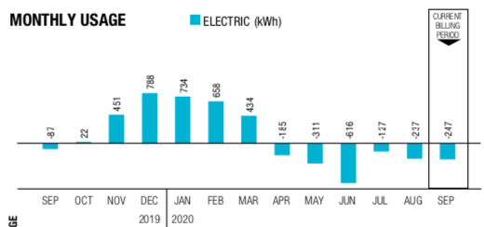
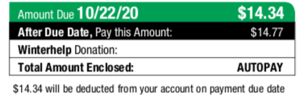

Slide 3
Before spending money on solar stuff…
Why add solar?
What’s it like to live with?
Terminology
What does it cost?
Free money!
Payback/Return on investment
Solar hot water
Off grid or grid tied
Inverter type
What would I need?
What’s involved in putting the system together?
Useful stuff/toys
State of solar power in Kentucky
Questions

Slide 4
Before spending money on solar stuff…
Energy audit ($100) In my case, this led me to:
Roof insulation (12+ inches extra fiberglass insulation) ($1200)
LED lights ($200)
Seal round windows and doors ($30)
Seal the air leaks from outlet boxes (same caulk for windows)
Seal the AC ducting and insulate the duct in the roof ($100)
Energy star roof shingles

Slide 5
Why add solar?
Low risk and high return investment: cash saved on electricity bill is after-tax lower bills are a big resale benefit
Good as part of retirement planning
Hedge against higher electricity prices in the future
Good for the planet (But so is walking places, riding a bike and going vegetarian)
It’s deeply cool making your own power
It is a fun DIY project
My friends and neighbors will be impressed/horrified

Slide 6
What’s it like to live with really?
With my system (7kw on the roof of my house, microinverters, net metering):
No maintenance (well, maybe hosing off the panels once in a while)
House is warmer in the winter, cooler in summer
Electricity bill is a touch more complex to read but a LOT smaller
Er, that’s it. Plug stuff in, it works.

Slide 7
Terminology
Inverter – a chunk of electronics that turns the direct current (DC) power from the panel(s) into alternating current (AC)
Kw – kilo-watt, a measure of power. A hairdryer or a drip coffee maker use about 1 kw, the dryer uses about 3 kw. A 3’x5’ solar panel makes about ¼ kw in really bright sunlight.
Kwh – kilo watt hour, or a load of 1 kw for 1 hour. When you look at the electricity bill, this is what they are counting. Before I started my house used about 40 kwh per day (2400 sq ft ranch). LG&E currently charge around $0.12/kwh.

Slide 8
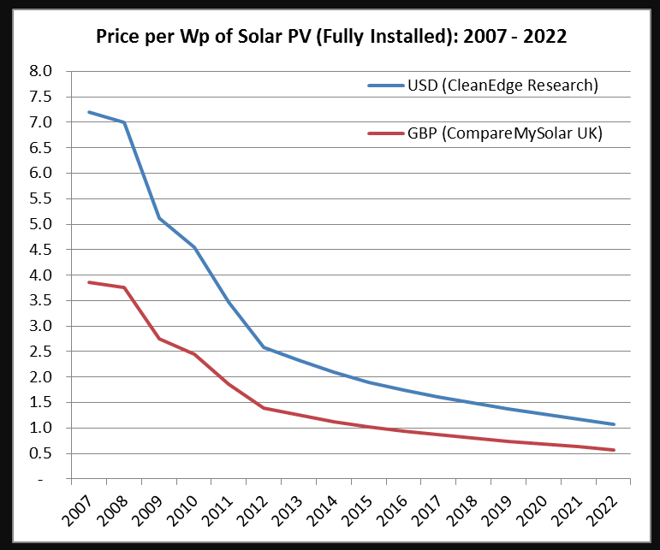
What does it cost?
Quote in 2013 for 3kw ground mount system was $18.5k.
Phase 1: 2013 DIY 5kw system (20 panels) - $11k (with $4.5k back) – the same system today would be $7k (with $2k back)
Phase 2: 2016 DIY 2kw from Craigslist - $2k
Neighbor bought 3kw DIY system from Craigslist for $3.4k
You can start with a single panel system for about $200…
Until the end of 2020 you get 26% back as a tax credit. 2021 is the last year, with 22% tax credit ☺
Solar hot water systems can be had for about $2k but plumbing can easily cost that much again.
Rough guide – DIY grid-tie is $1/w, professional grid-tie install is $3/w to $4/w and off grid with batteries is going to be around $6/w to $7/w.

Slide 9
Free Money!
First, the Federal government will give you a 26% tax credit on all money you spend on solar (water heating and photovoltaic equipment).
That 26% also includes tools, wiring, nails, bolts, electrical and plumbing changes, electrician fees, engineering fees, permitting costs and so on. It does NOT cover your labor if you install it yourself, nor does it cover replacing your roof.
Second if you run a business from your house and you live in a rural area (Oldham county for example counts) you can apply to “Rural Energy for America Program” for grants and loans of up to $20k .

Slide 10
Payback/return on investment
There is a LOT of rubbish talked about how long solar takes to pay for itself, and it is rubbish because it implicitly assumes the installed solar panels have zero value once you install them.
The correct way to price them is as an investment, where the install cost is the capital, and the saved money from bills is the (after tax) interest on that capital.
Any steps you take to reduce your future bills are useful as part of retirement planning.
Buying roof insulation, better windows, sealing behind outlets and solar energy can be thought of as techniques to buy yourself lower bills (and more disposable income) in the future.
With the Federal tax credit of 26% this year, the government is helping out here more than in any other retirement investment.
Energy improvements are unlinked to market prices, and indeed tend to be more valuable in times with high energy price volatility.

Slide 11
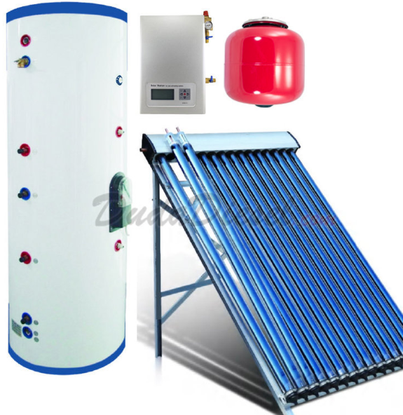
Solar hot water
Preheats water before it runs into your hot water tank
Solar collector on the roof, with a circulator pump and additional hot water tank
Water heating is 10%+ of house energy use
Best done as addition to current hot water system (preheat tank)
Some lifestyle changes …you want to run the washer, dishwasher etc. at night

Slide 12
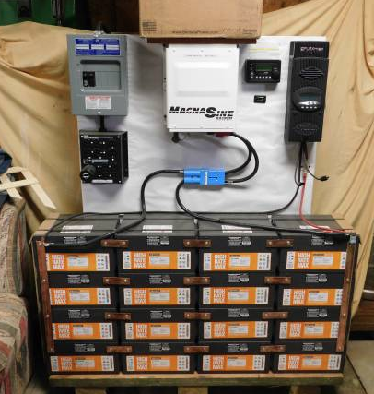
Off grid
Off grid – no electricity bill ☺
You provide all your own power – and don’t depend on the grid.
Significantly more expensive because it uses (lots of) batteries
Regular maintenance for batteries, and they need to be replaced every 10 years.
Bad weather for prolonged periods means using backup generator
Great if the utility wants more than $50k to connect you to the grid
Almost impossible to find a professional installer that will do this for you.
*This is badly wired – don’t do this!

Slide 13
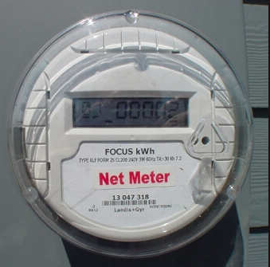
Grid tied
Grid tied – your house is still connected to the grid
You still get a bill ☹
If there’s snow on the panels for a week you still have power
You don’t have to replace all your power consumption with solar
Very low maintenance
This is what I have...

Slide 14
What would I need for grid tied PV?
You don’t need to replace all the power you use from the grid – start small, but get the meter changed THIS YEAR!
Sun! So you need a clear view of the southern sky
Roof or space in the yard
Size of system is measured in kW – one panel is about 3’x5’ and makes about ¼ kW.
System comprises panels, inverters, wiring and a mounting system
If you needed 25kwh/day, we get about 5 hours of sunshine per day so you would need 25 / 5 or 5kw of solar panels, about 20 panels.

Slide 15
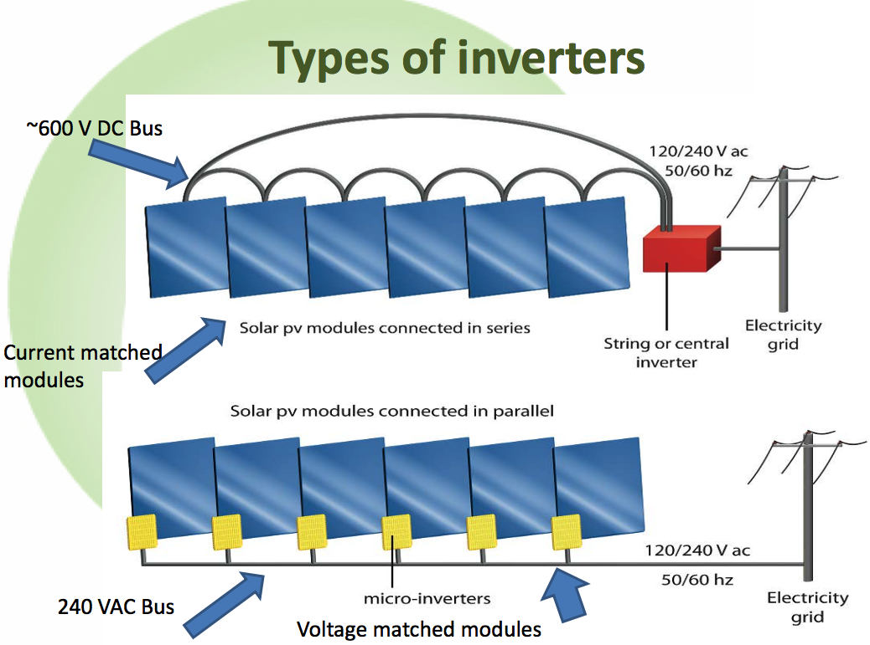
Pros | Cons
Cost (cheapest option) | Shading
Inverter inside | High voltage DC
 | Modules must be matched
 | Single Point failure
 | Can only add on matching modules
Pros | Cons
Module level metrics | Cost (for larger arrays)
Can add one at any time | Electronics all located on roof
Longer warranty typically (25 yrs vs. 12)
Each panel optimized
Pros | Cons
Module level metrics | Cost (for smaller arrays)
Can add one at any time up to inverter max | High Voltage DC (but not as high as option #1)
Inverter inside | Single Point failure
Each panel optimized
Wattage matched modules plugged into power optimizers which are connected in series

Slide 16
Inverter types
“Single string” photovoltaic solar power One or two large inverters fed by multiple panels wired together, although some inverters accept multiple strings.
“Micro-inverter” photovoltaic solar power One inverter every one or two panels
“Hybrid inverter” – grid tied inverter which can also provide power if the grid goes down. There are examples that are Enphase Ensemble (which uses string inverters) or Solar Edge StorEdge.
“Reserve Power” – Optimized string inverter but with a separate “off-grid” outlet and a physical switch to activate it. Allows limited (2kw) AC for internet, phone charging and maybe extending the time the freezer stays cold.
Note: Enphase is the biggest microinverter supplier, and Solar Edge is the biggest optimized string inverter supplier.

Slide 17
What’s involved in putting it together?
Plan system
Apply for net meter (See links)
Get electrical permit (As a home owner, you can do electrical work except anything requiring a utility disconnection/ reconnection)
Get building permit (Beware, if you have trusses you will need a structural analysis)
Order parts
Install system
Get electrical inspection
Get net meter
Go live!

Slide 18
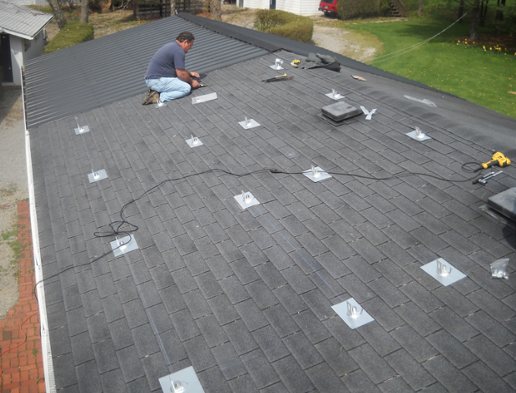
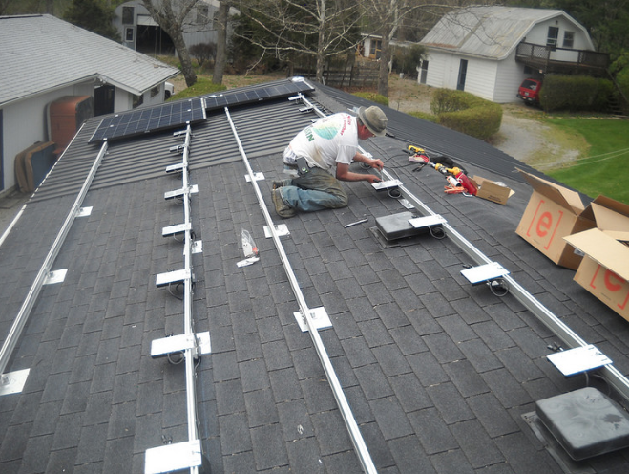

Slide 19
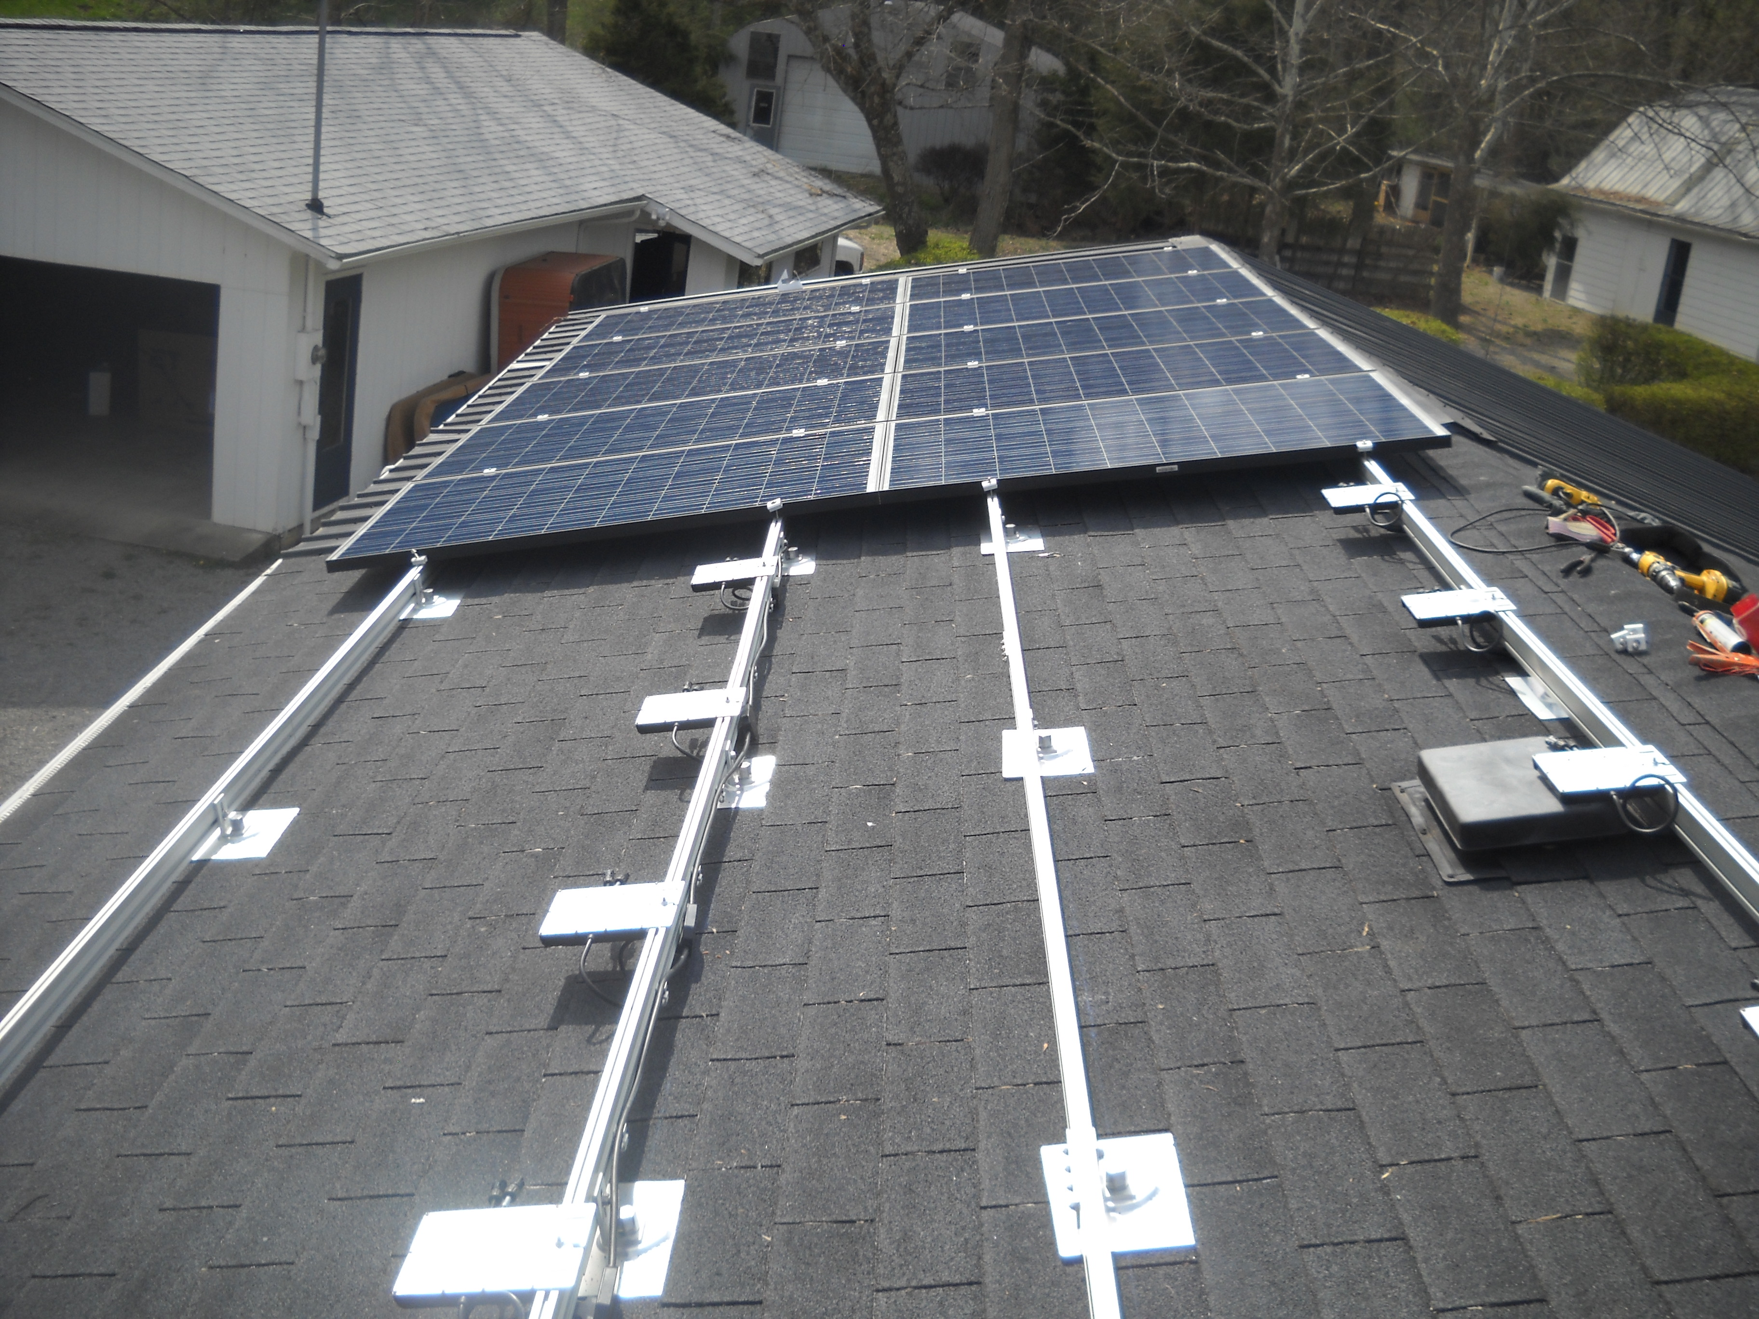
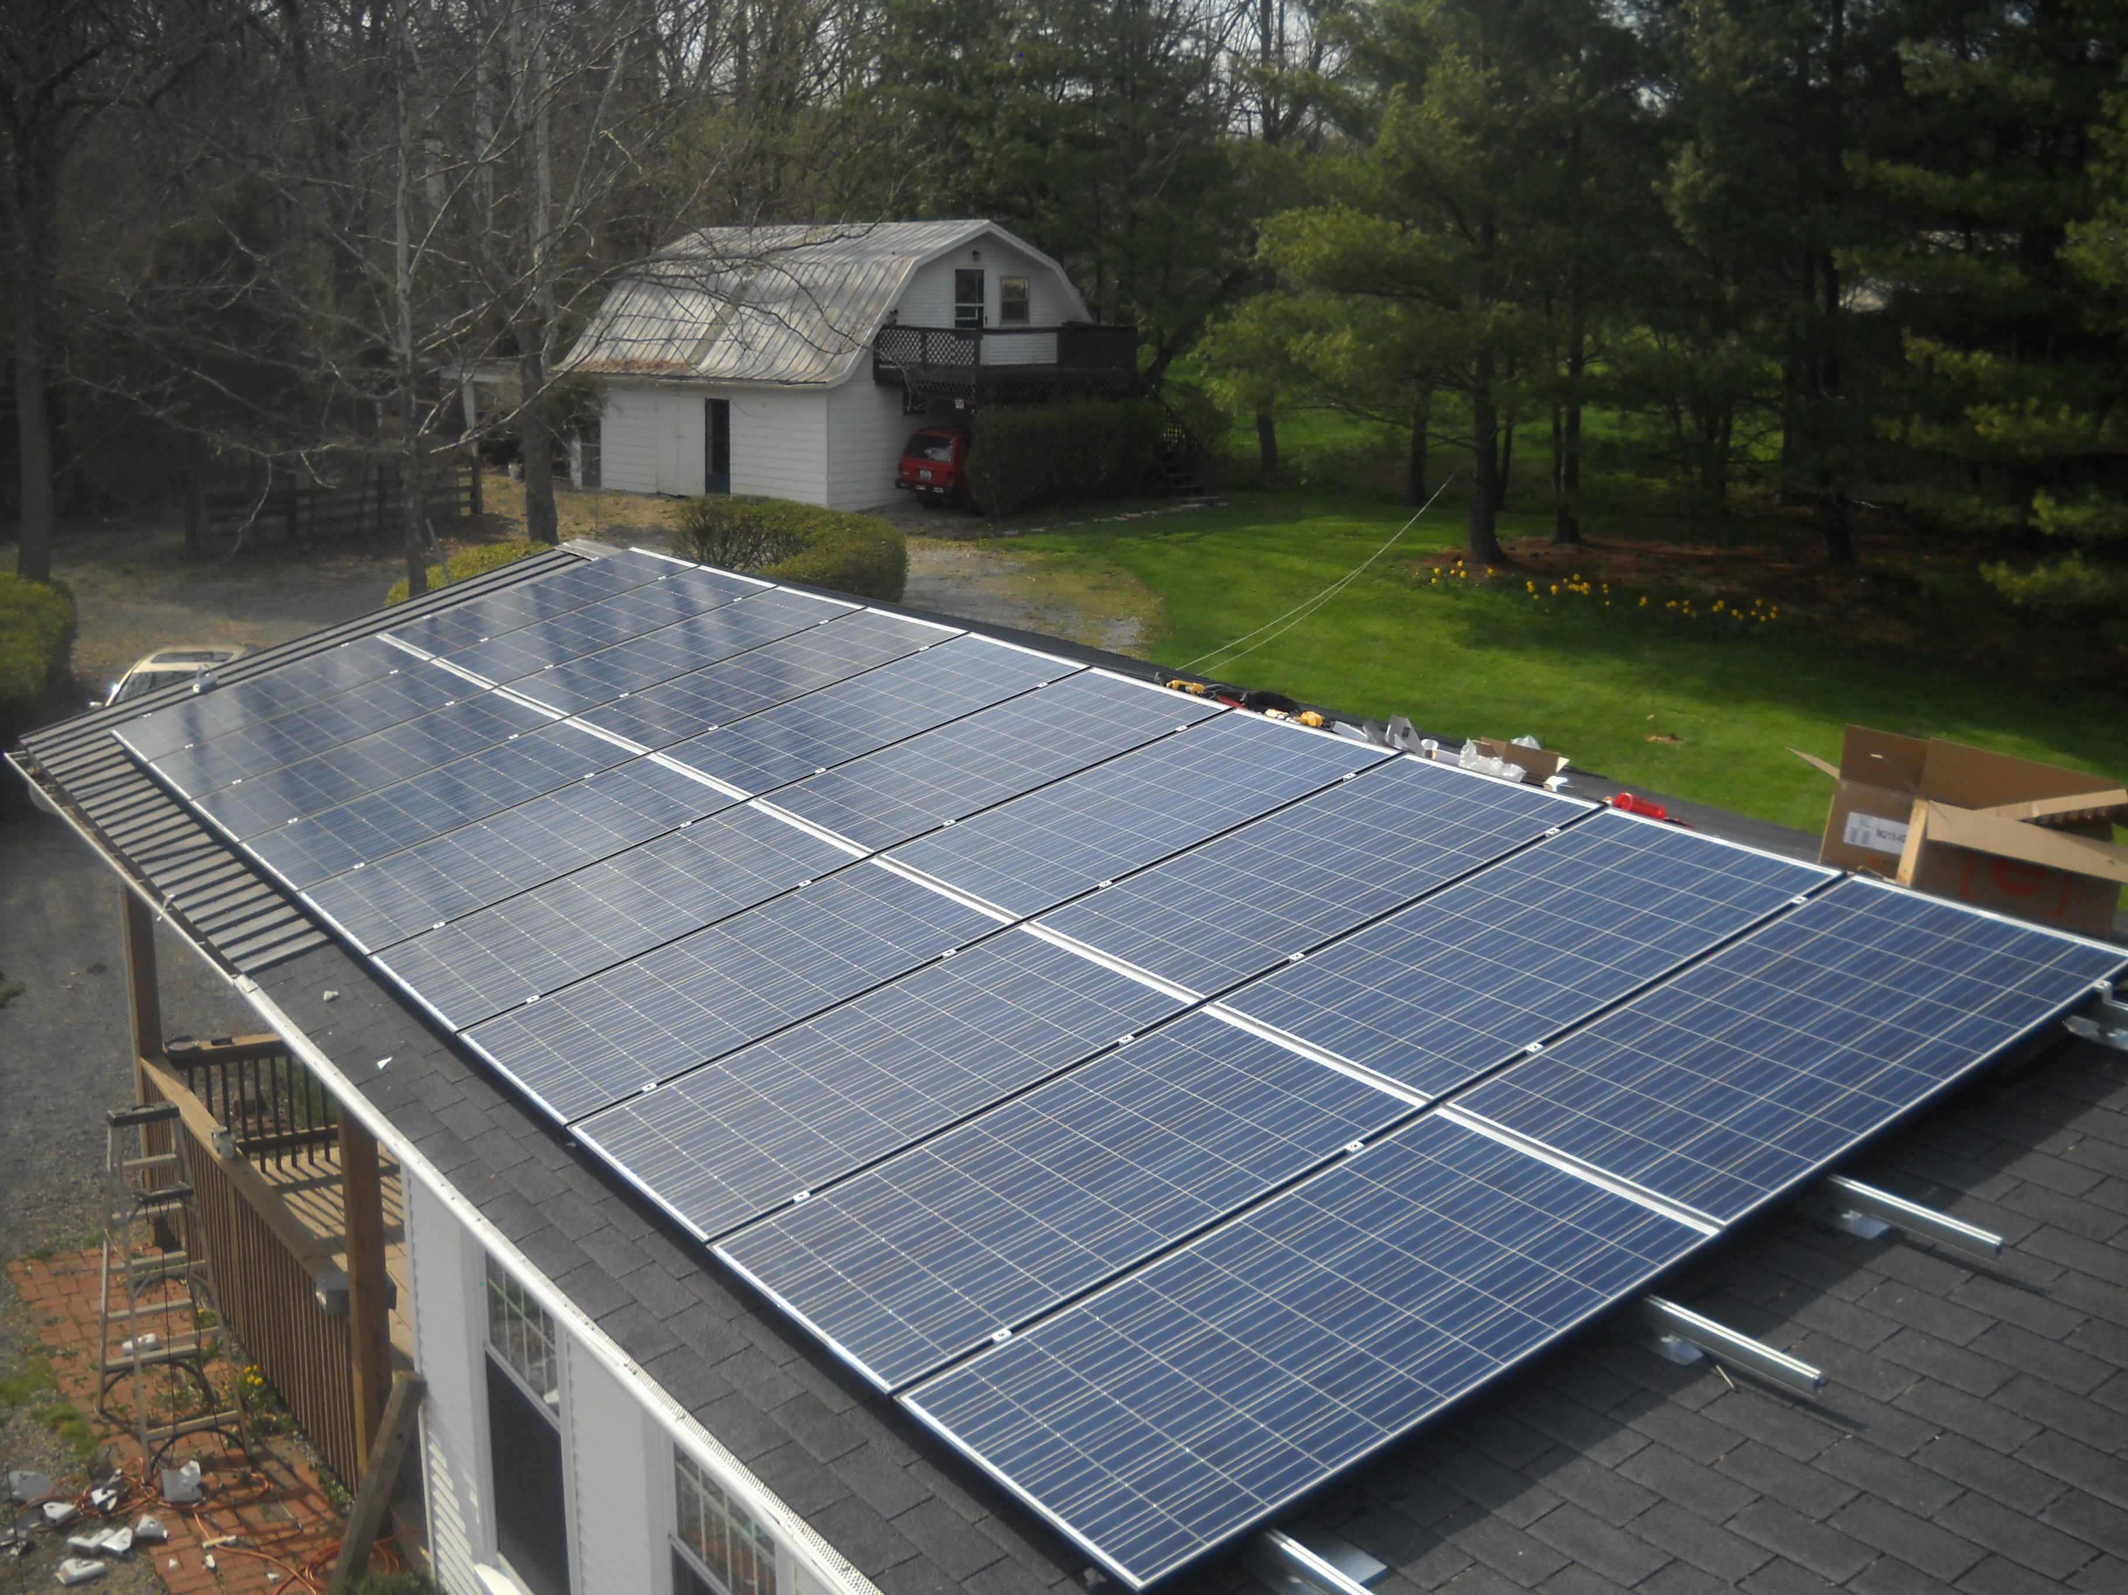

Slide 20
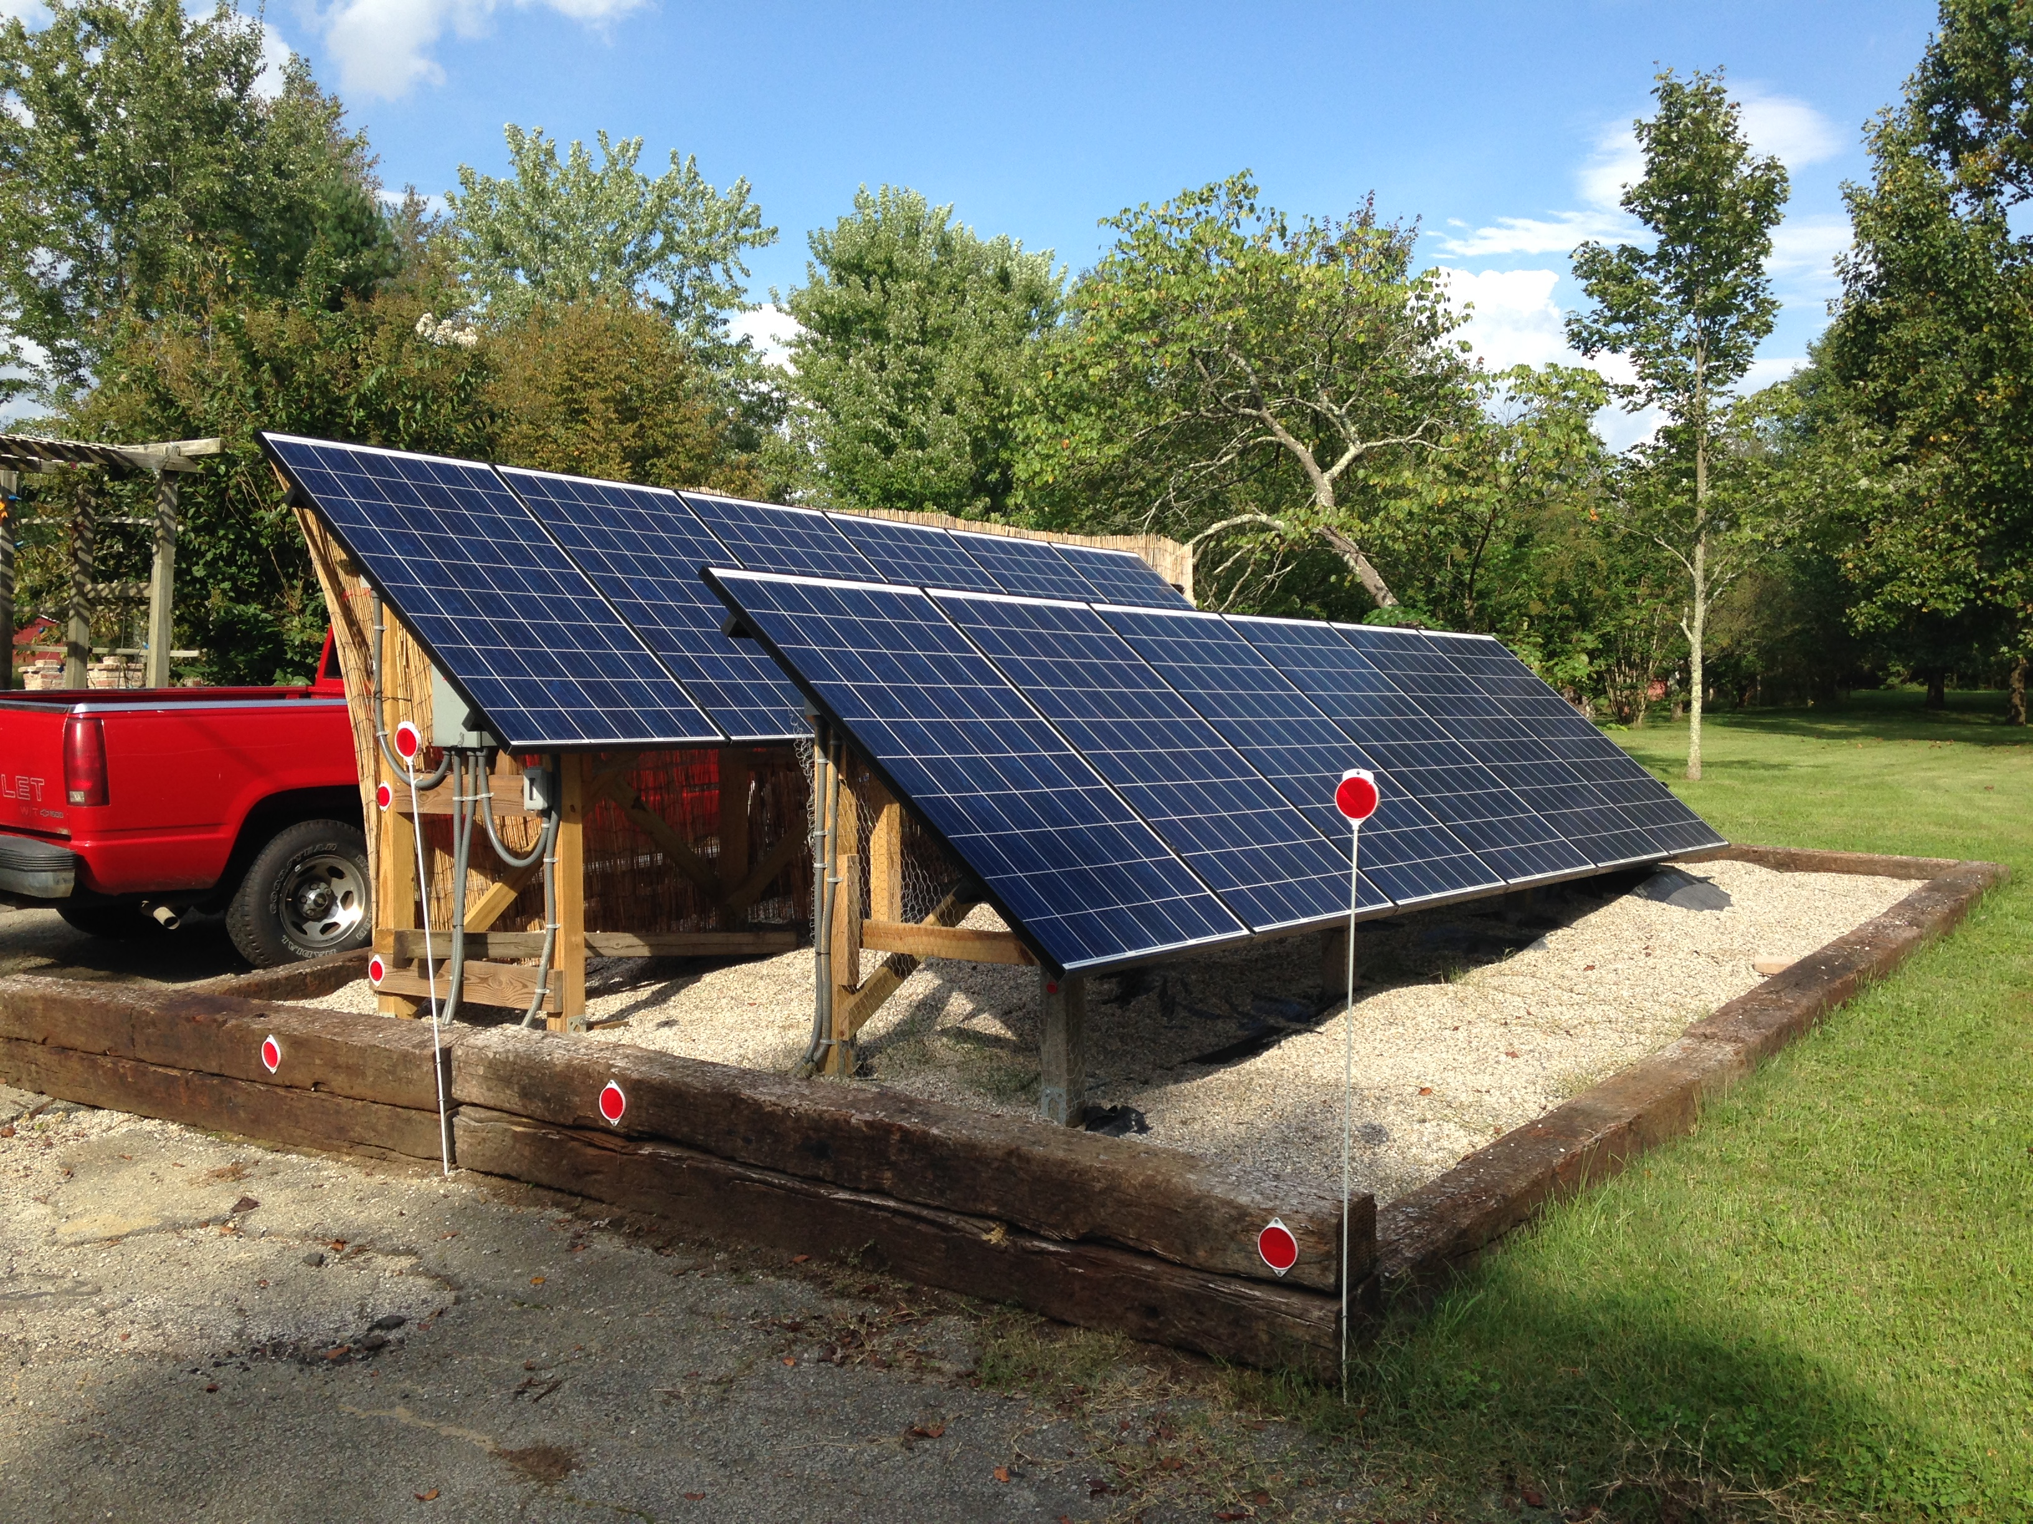
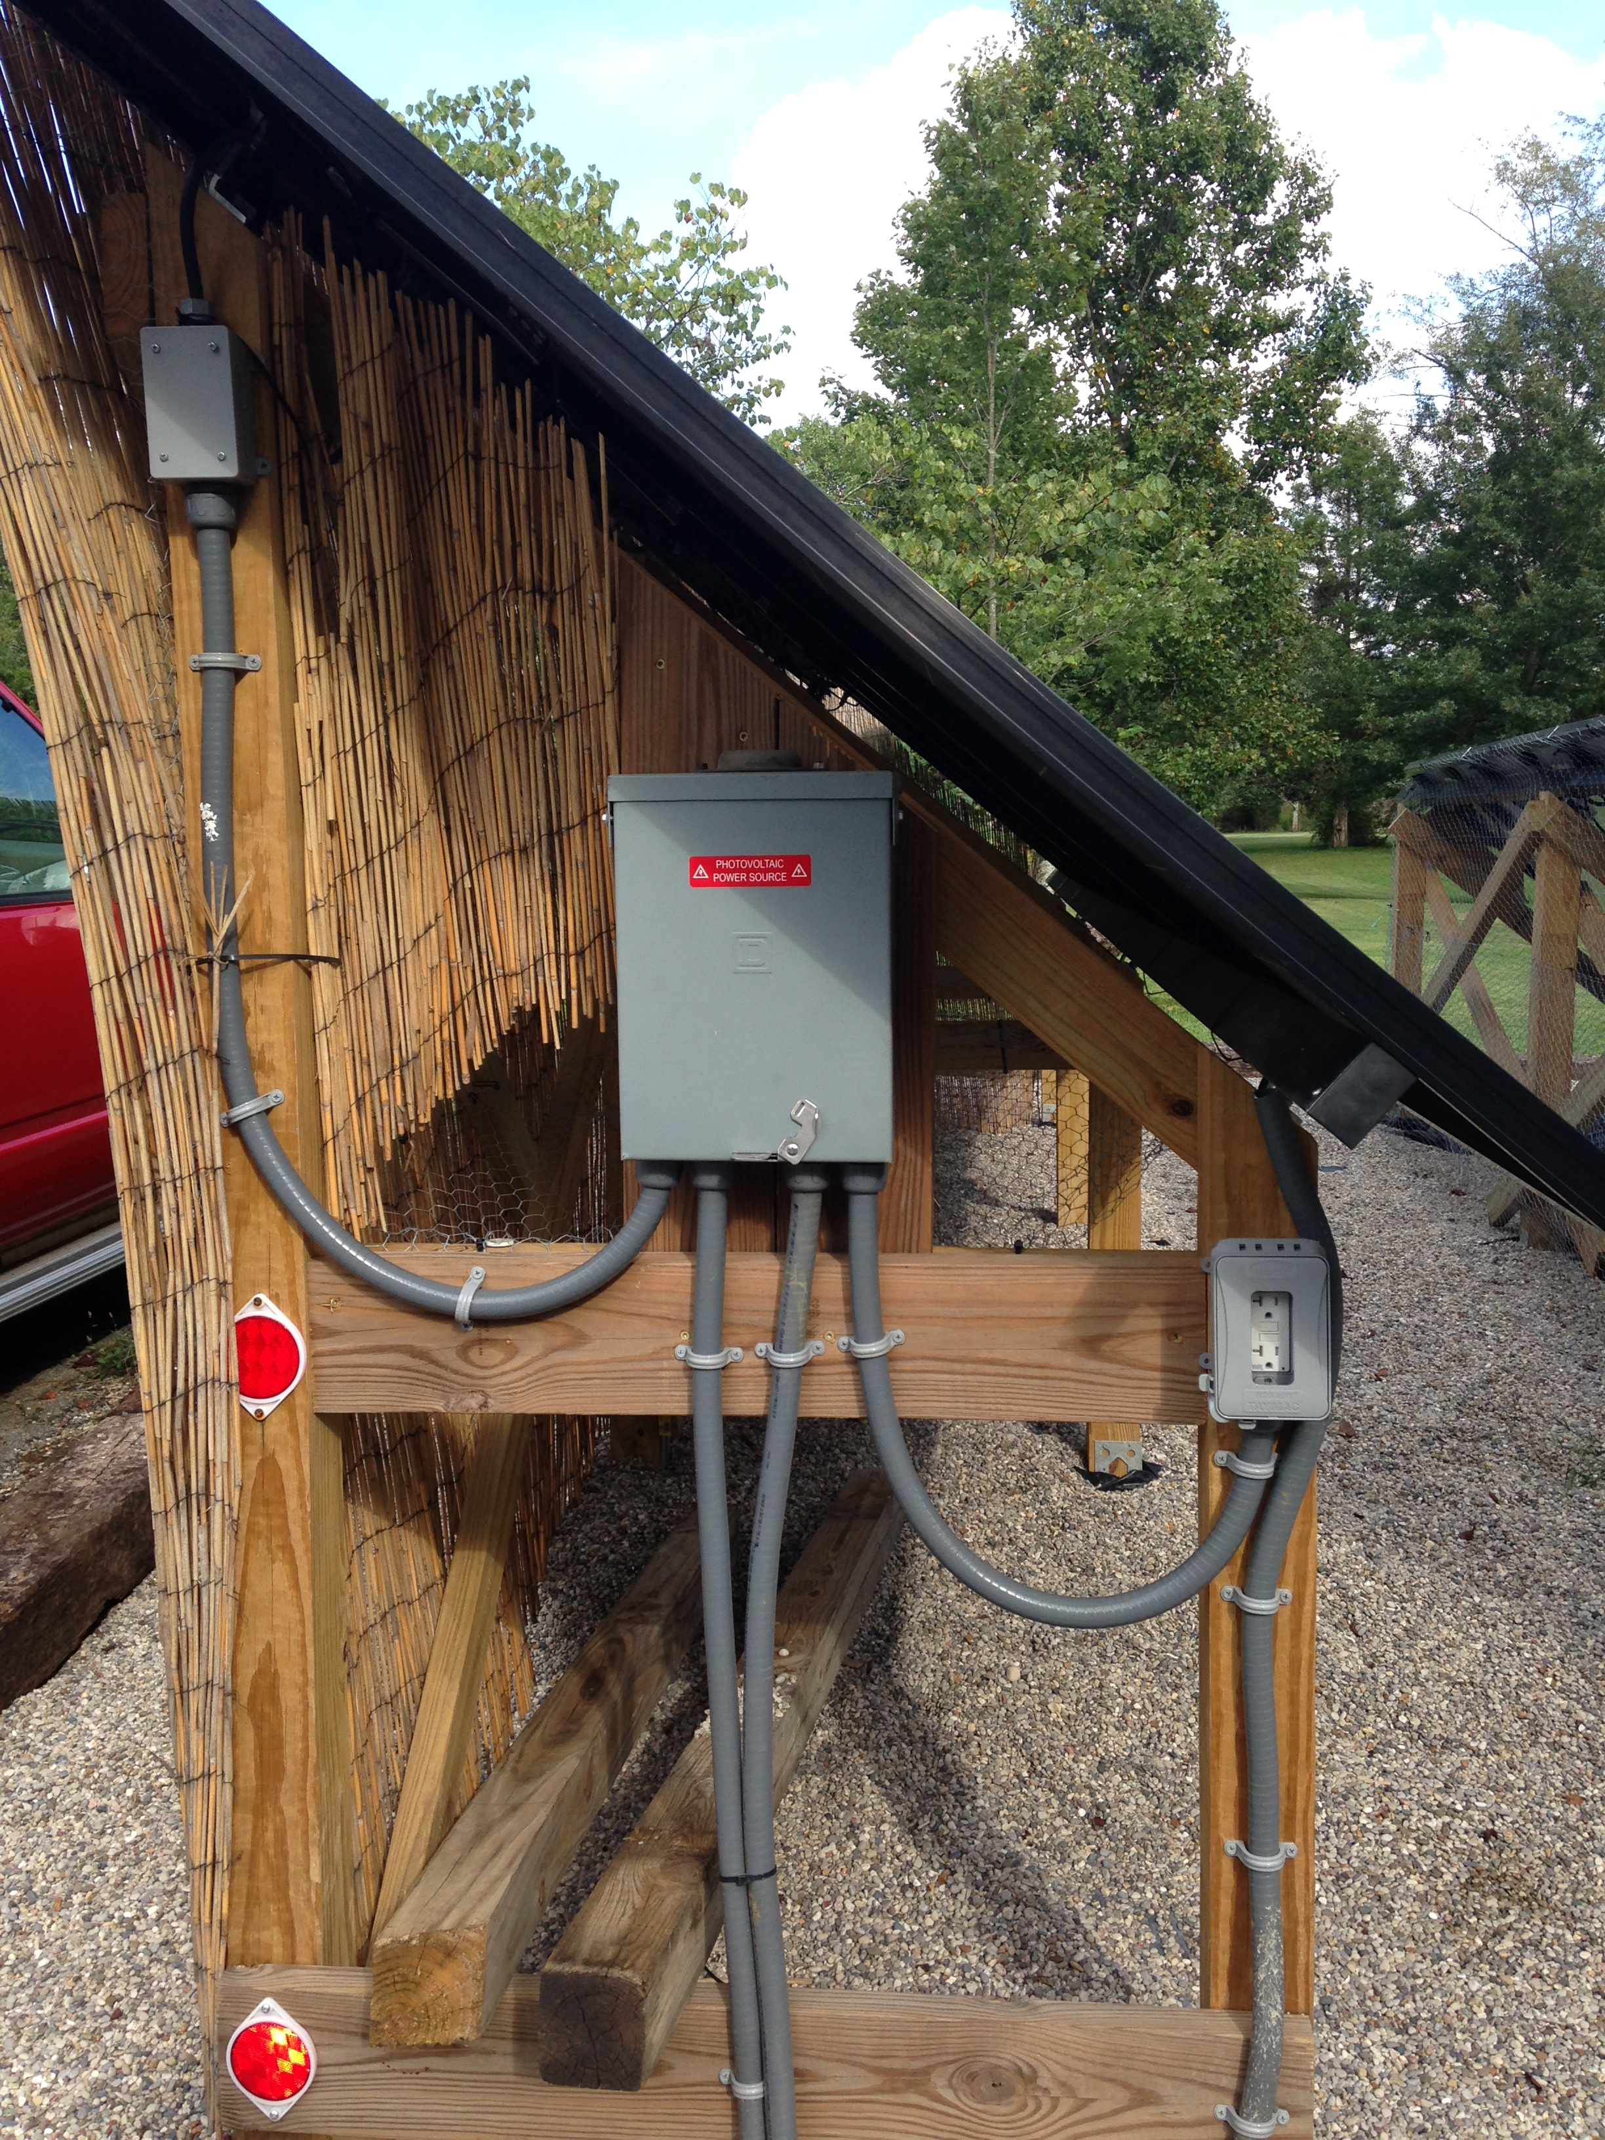

Slide 21
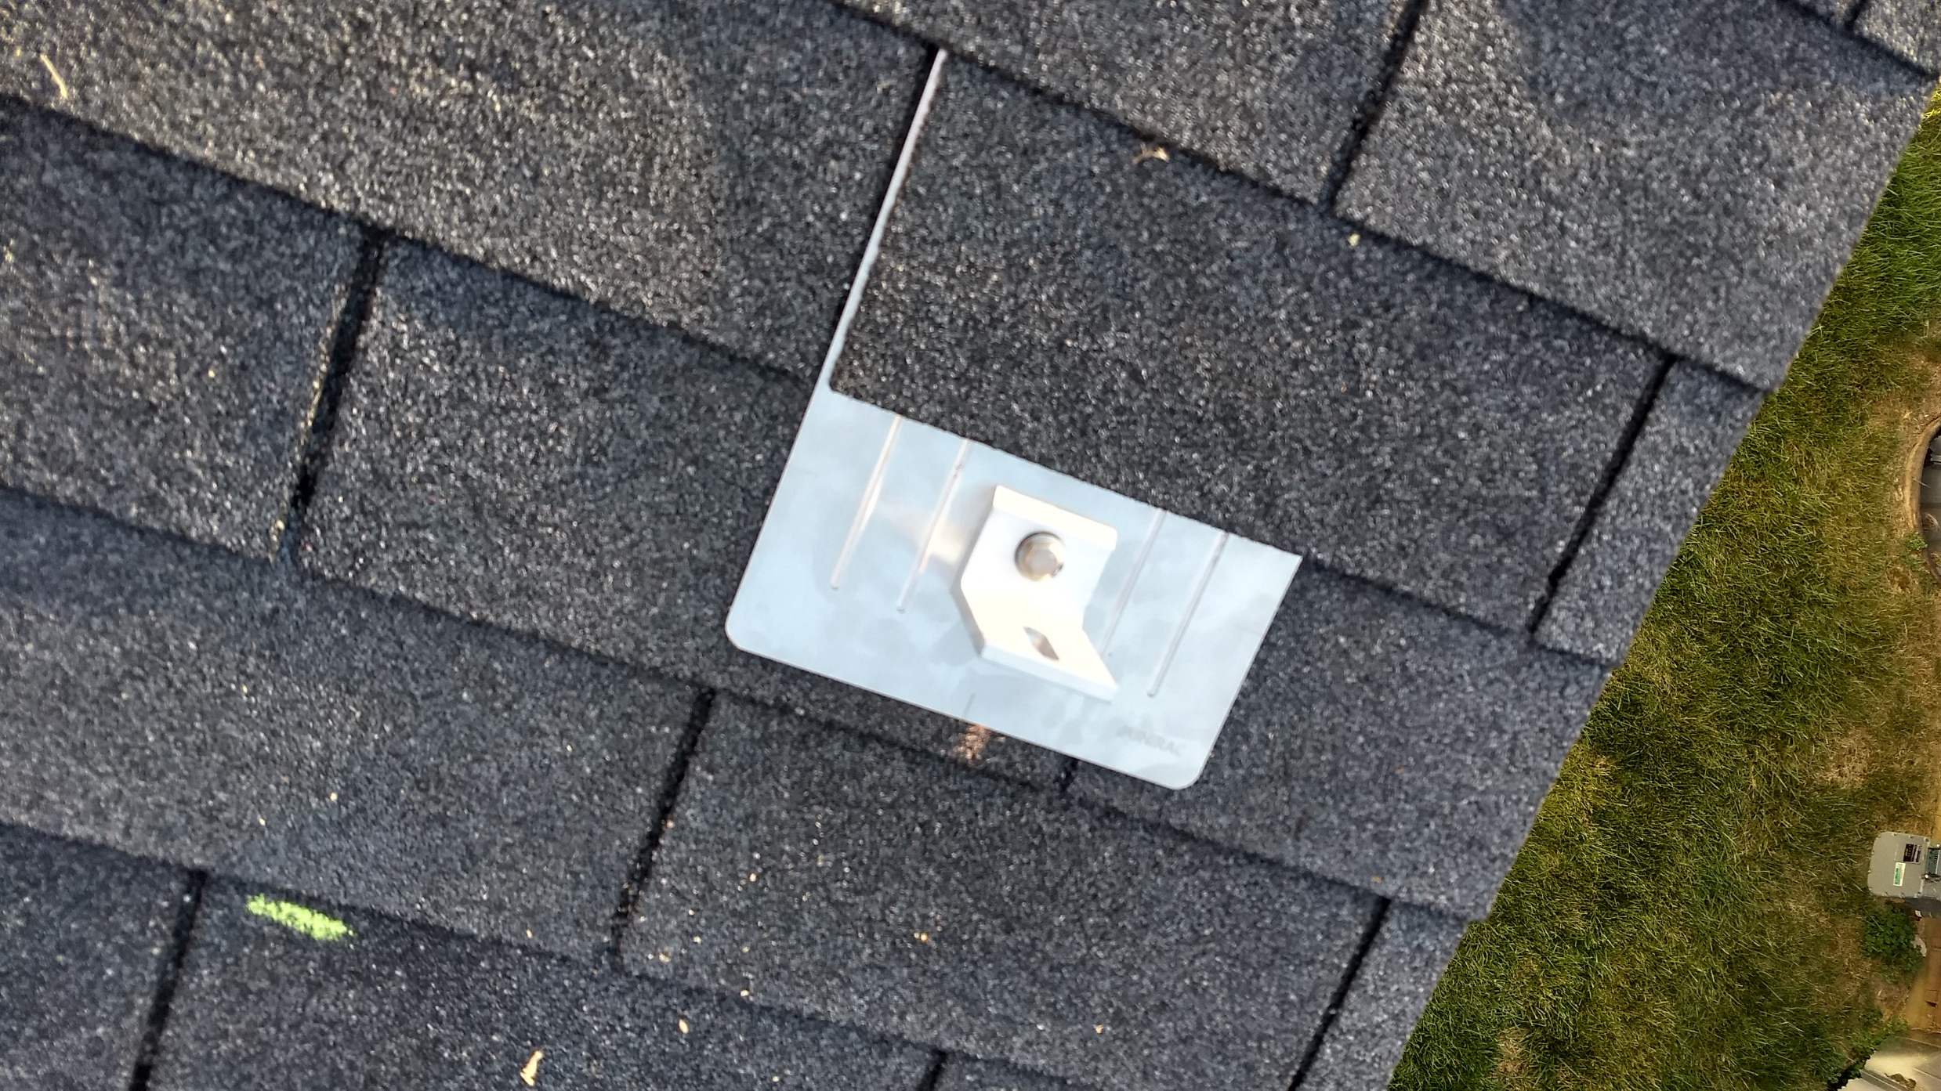
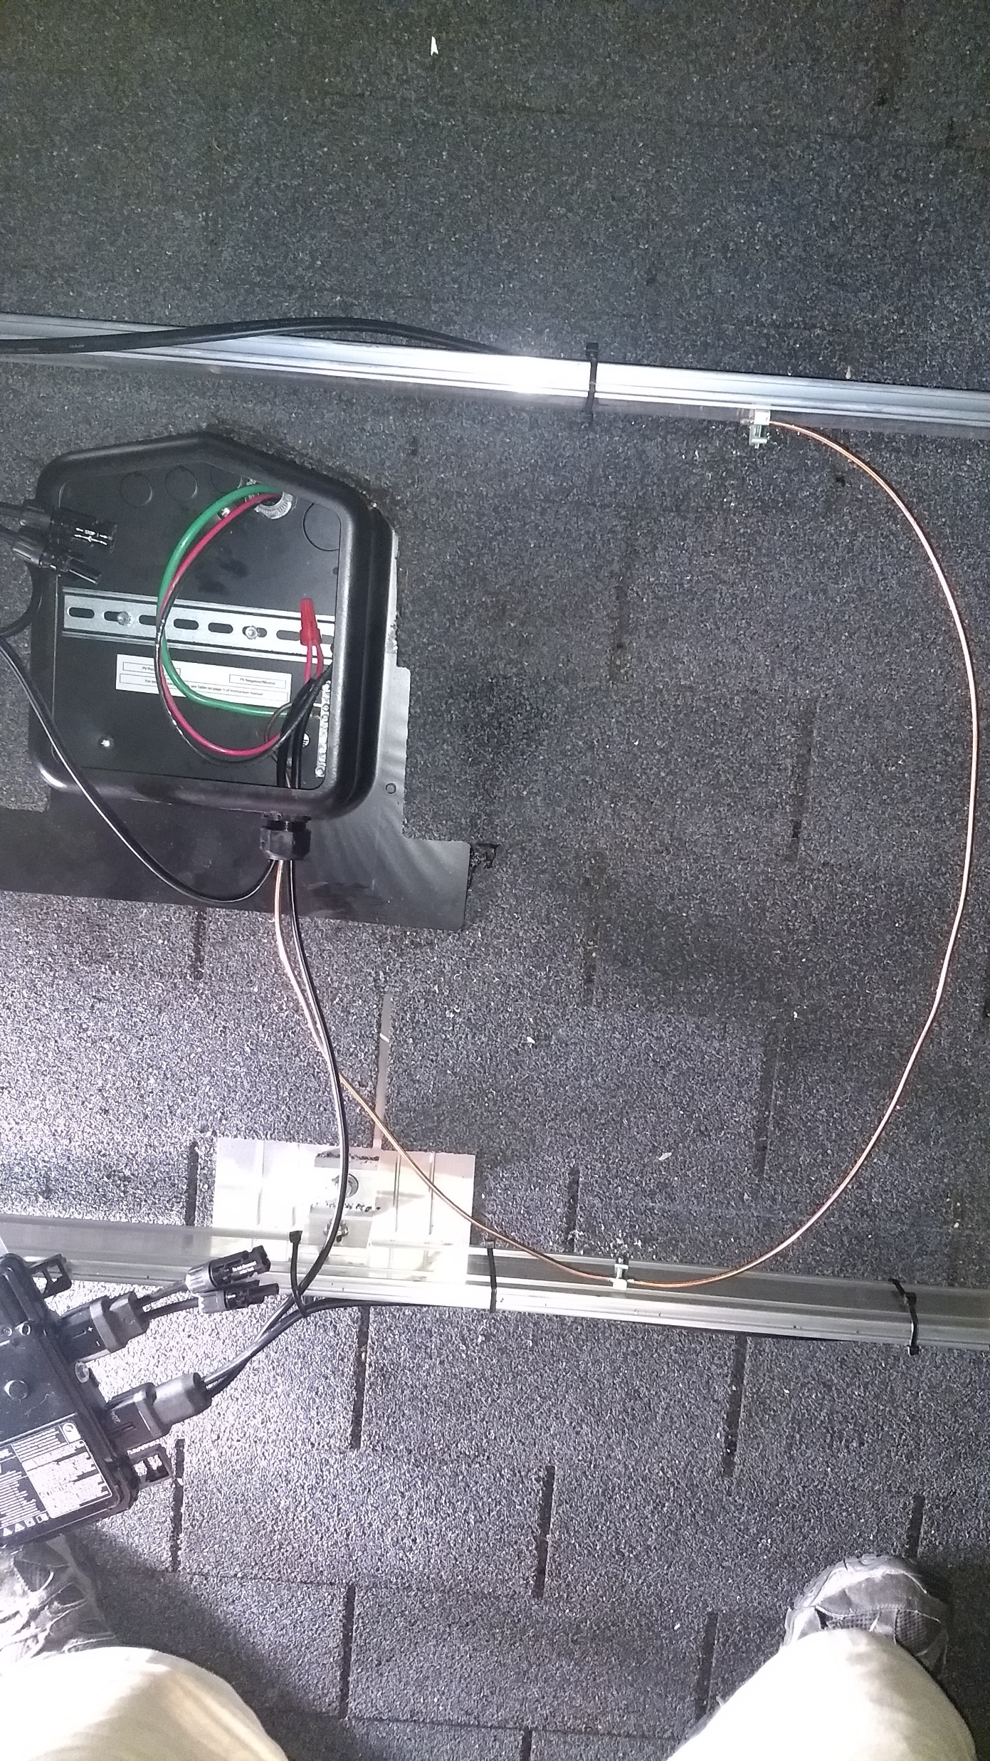
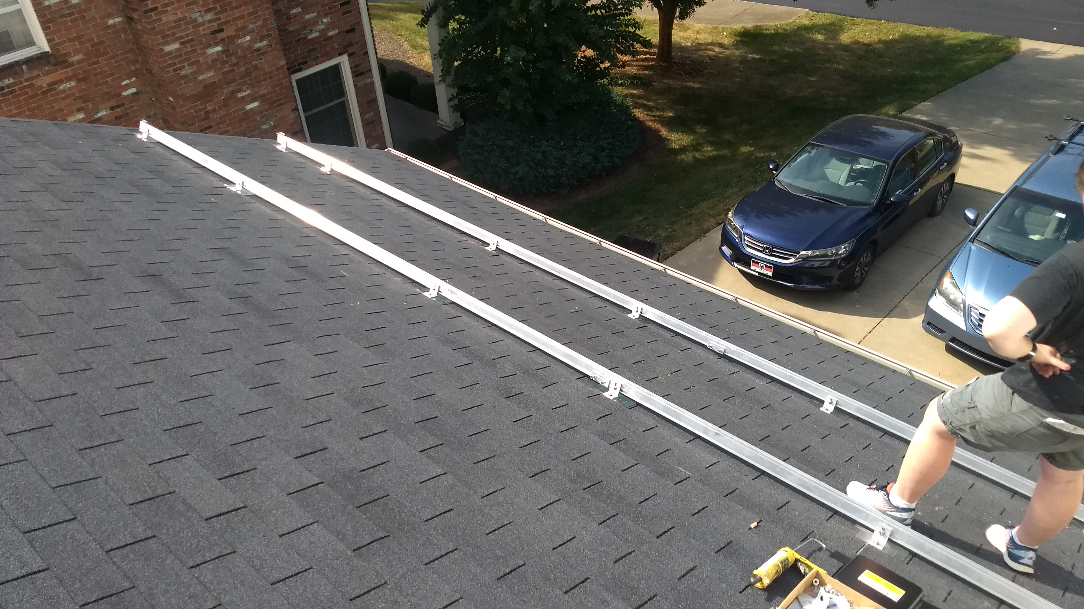

Slide 22
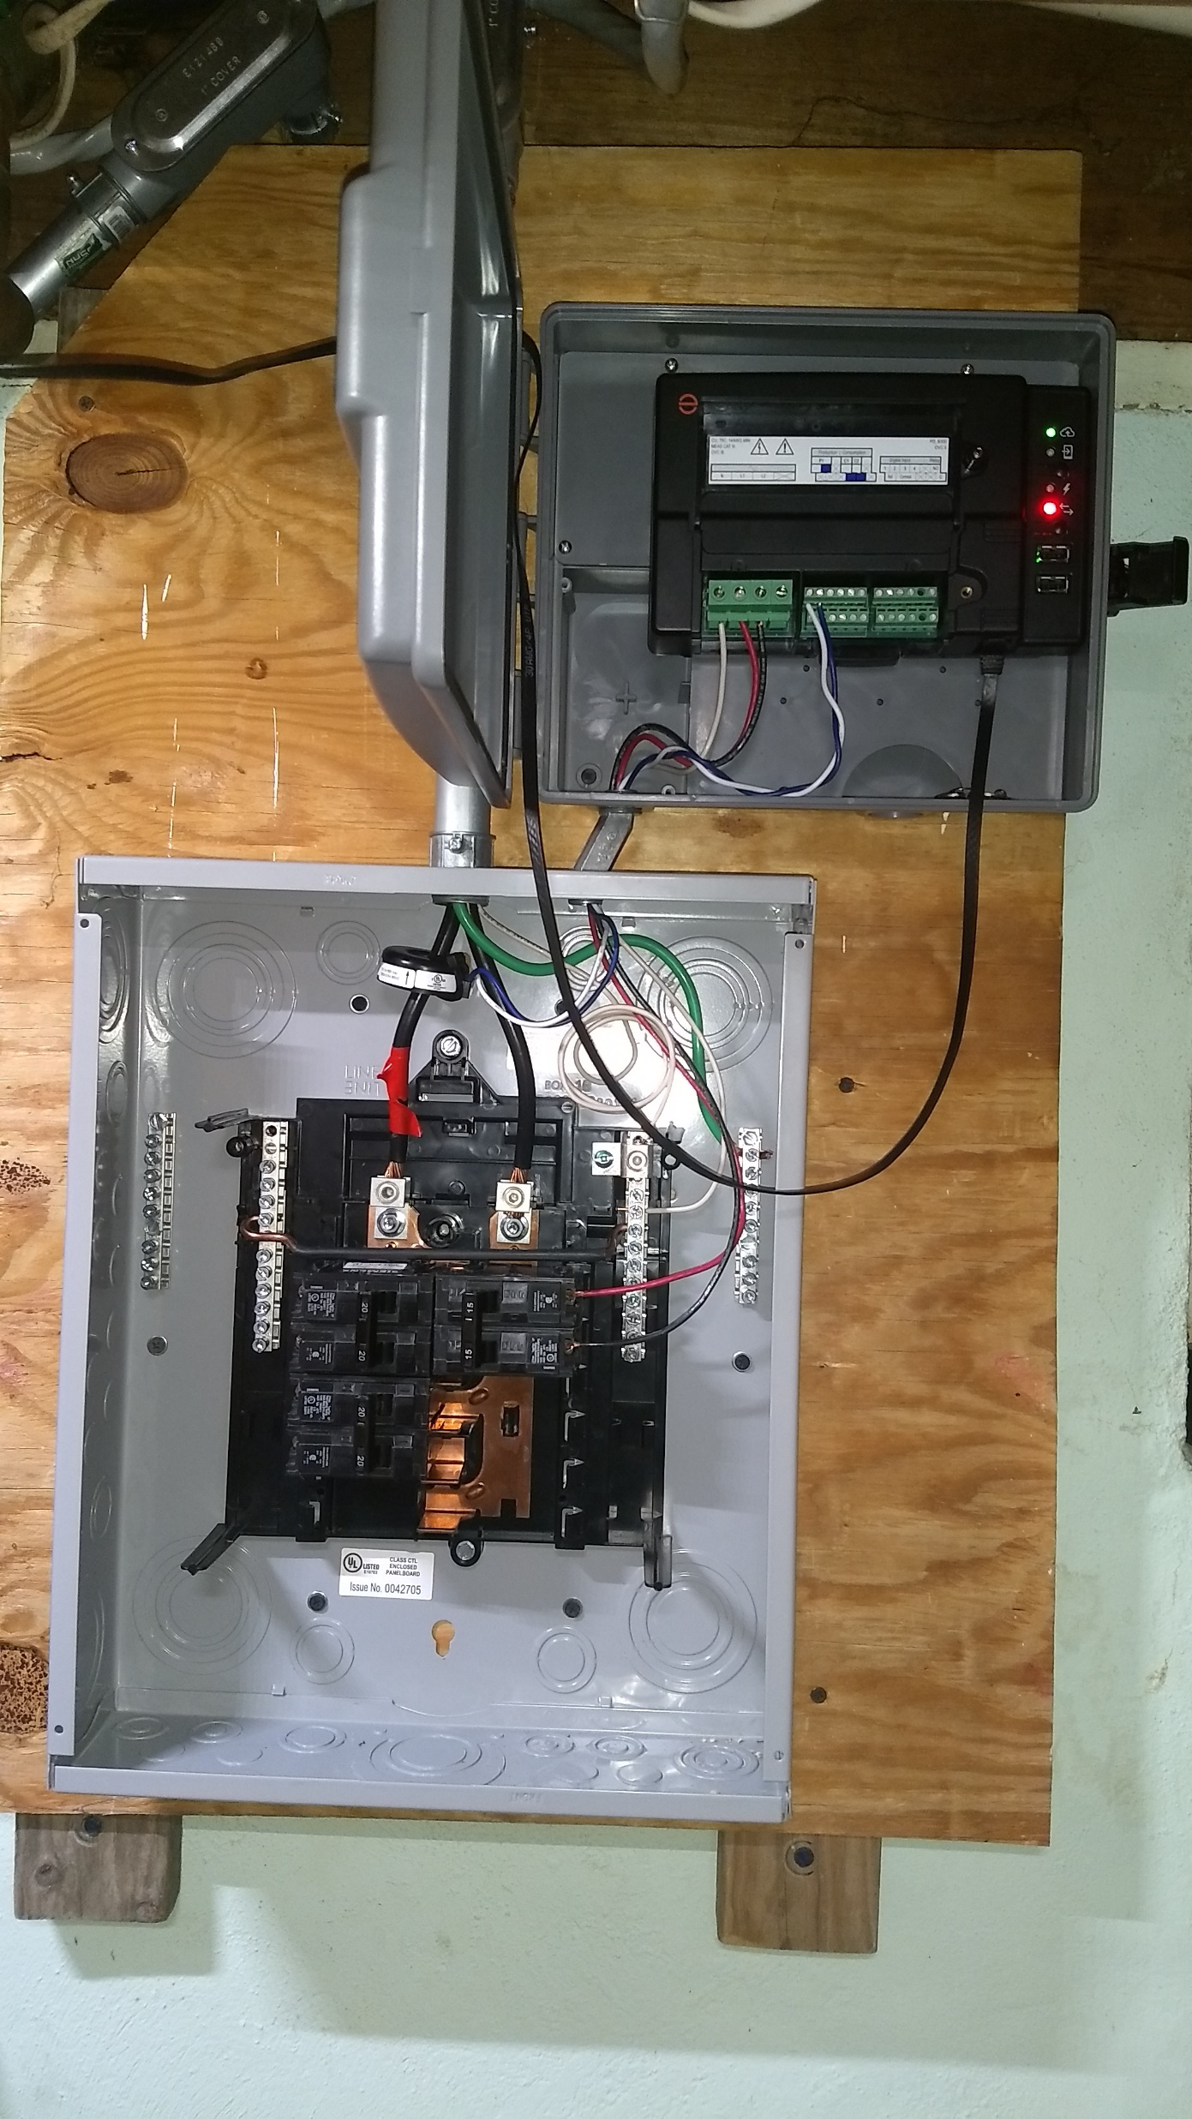
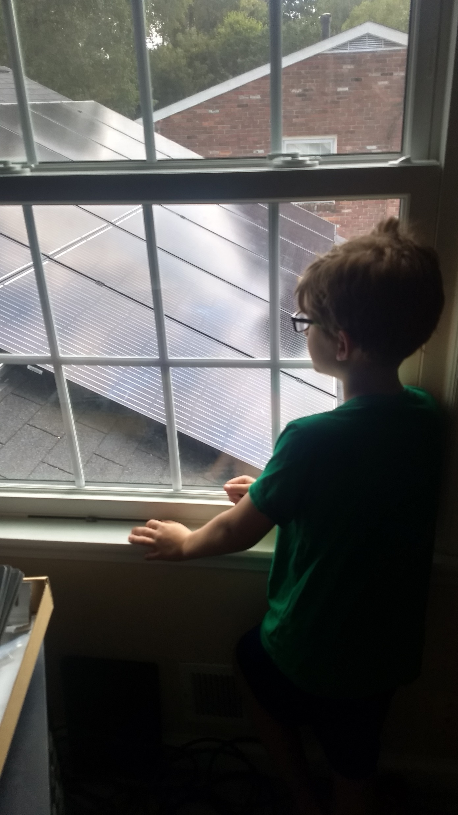
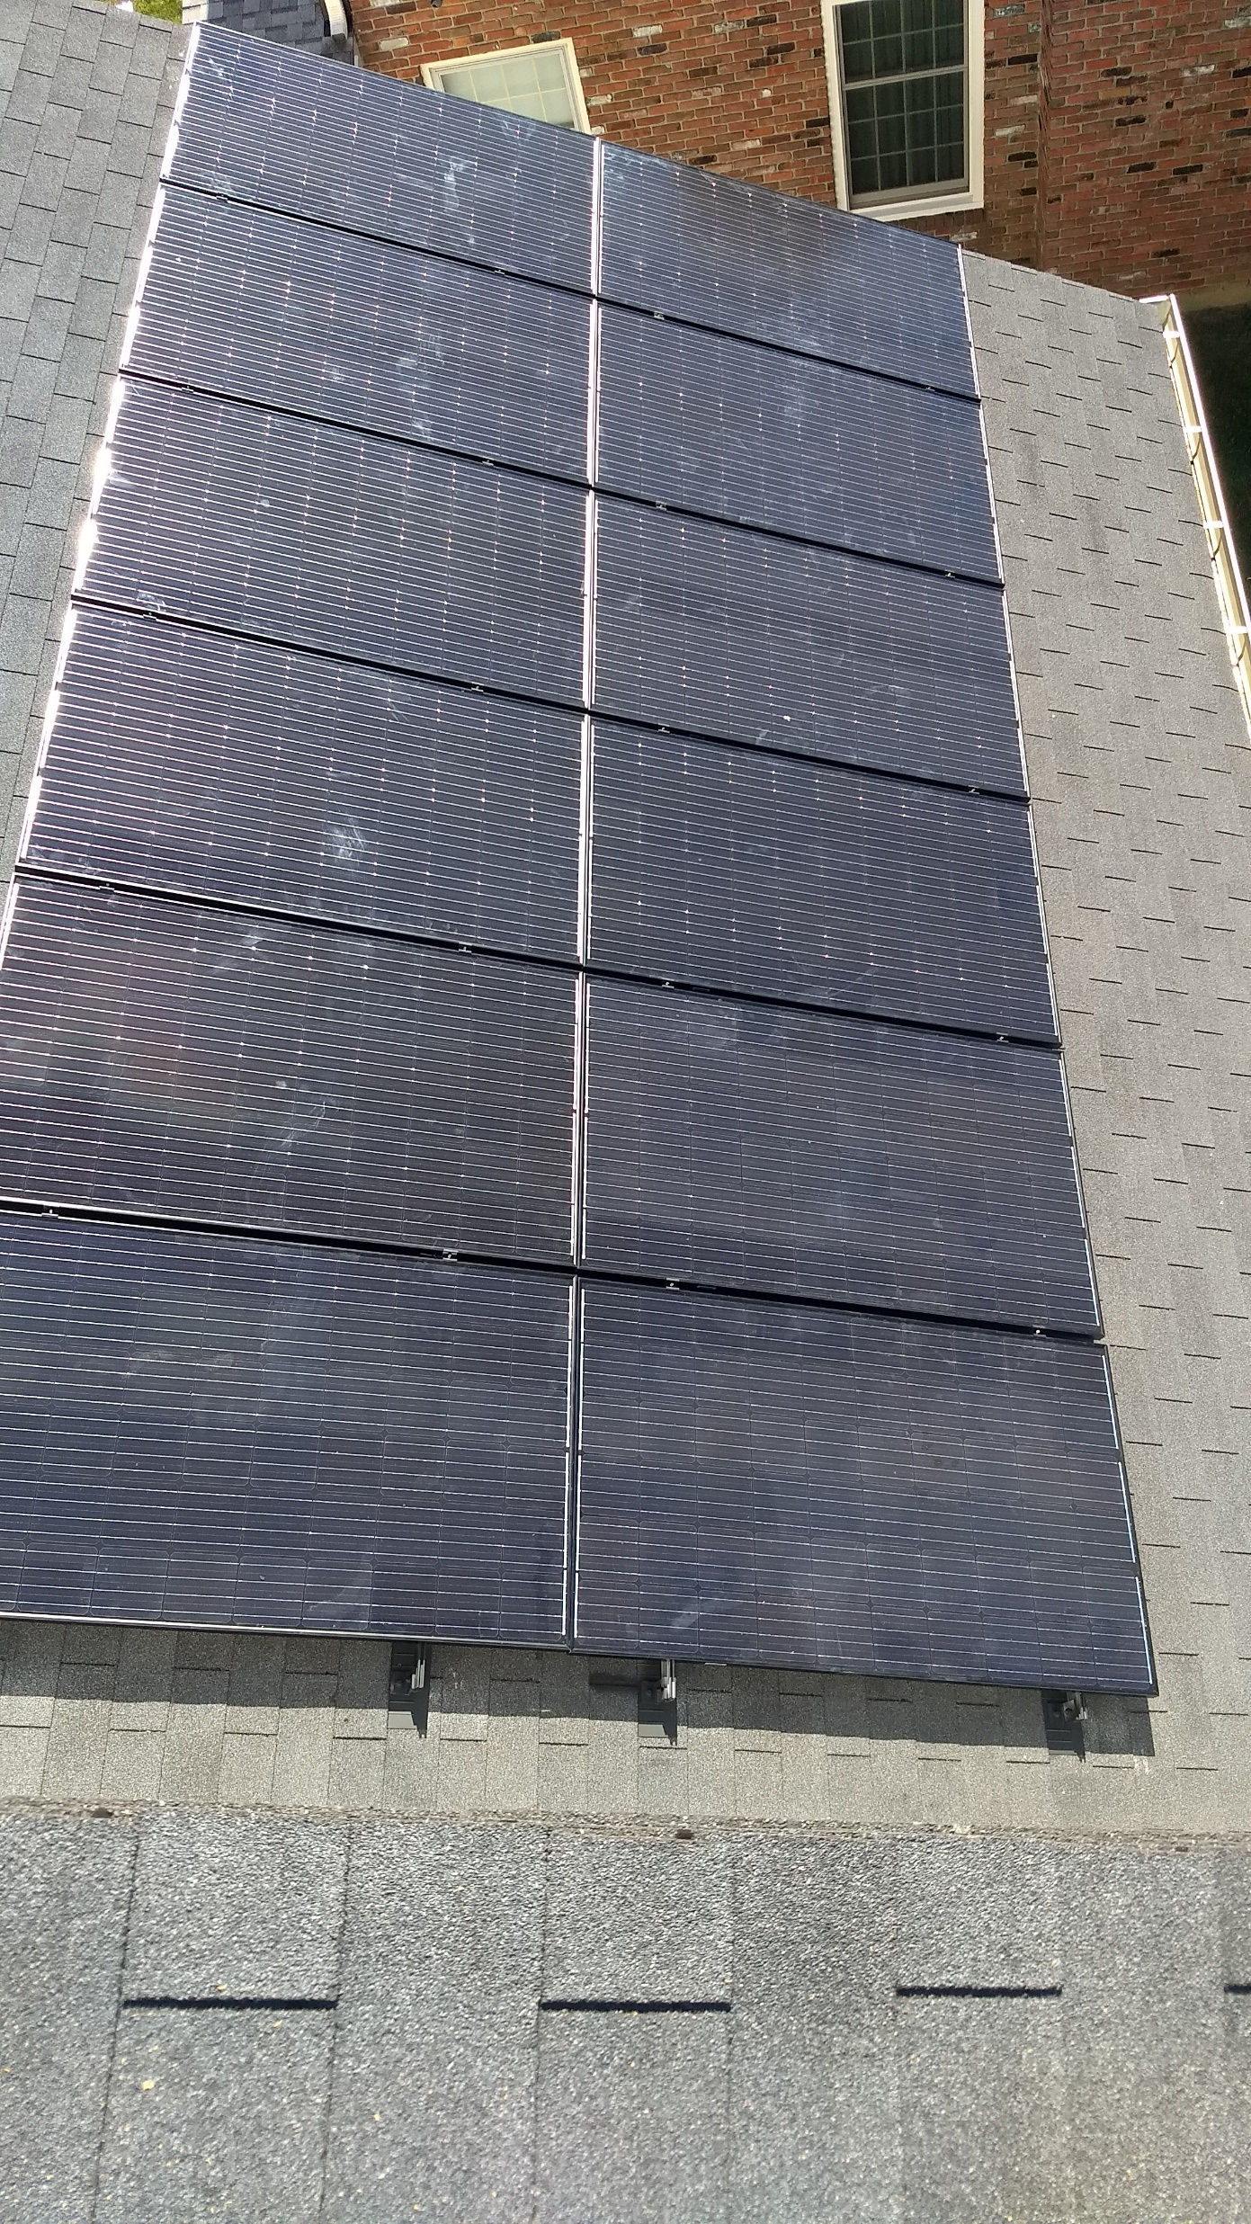

Slide 23
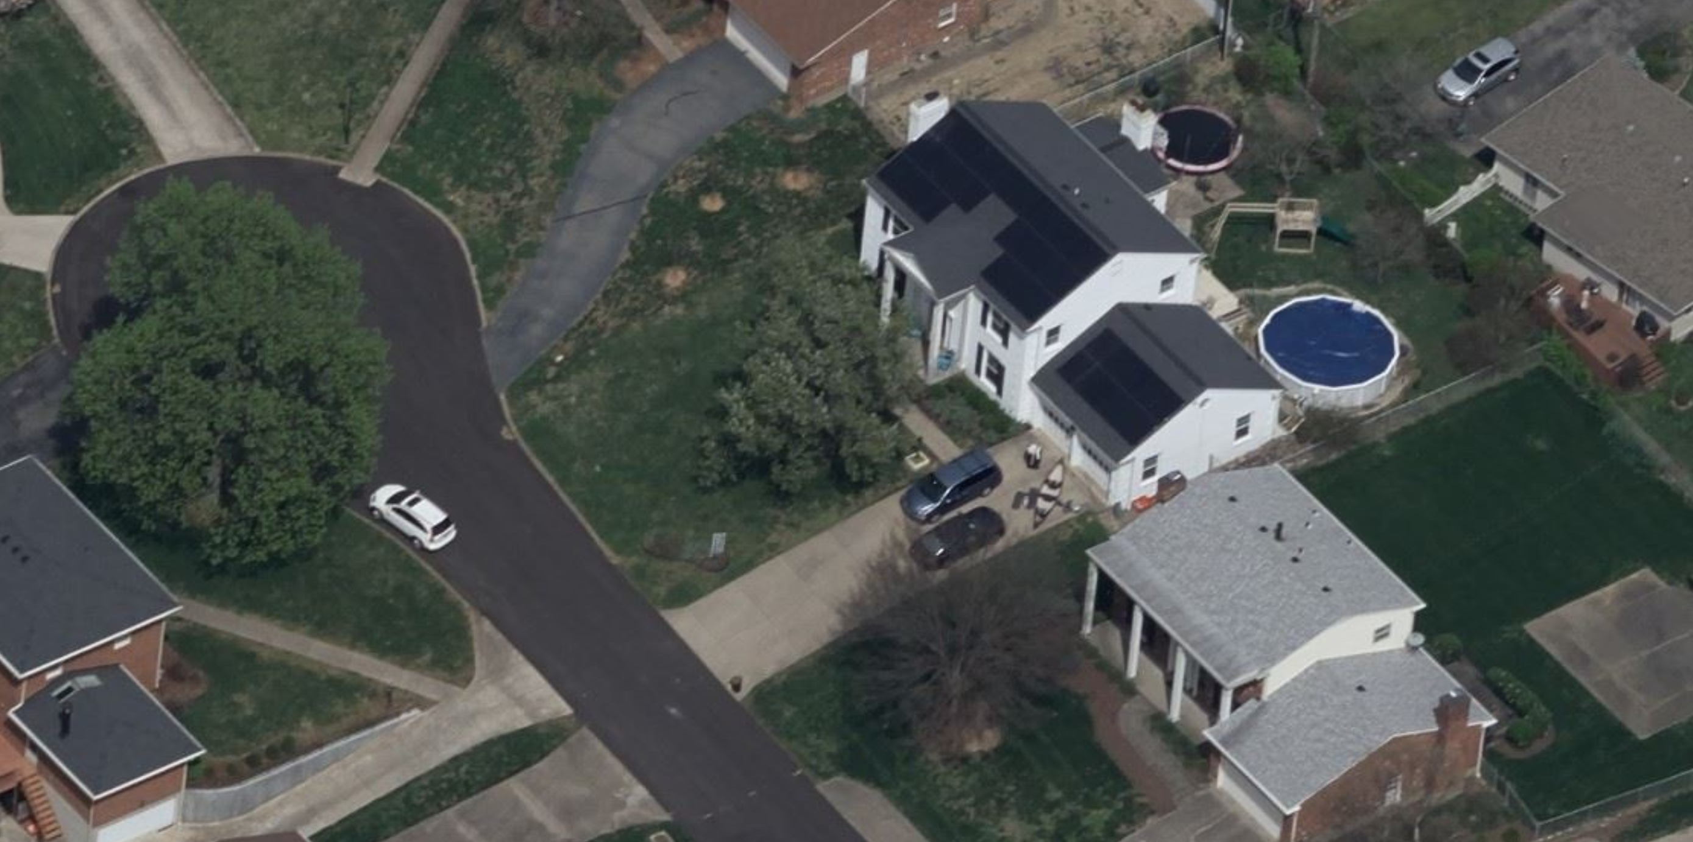

Slide 24
You CANNOT miss Net Metering
Since 9/29/2019 | Negative means bought
 | kWh | $
No Solar Cost | (17,742.08) | $ (1,714.02)
Generated | 15,876.24 | $ 1,537.87
Net Metering ($) | (1,865.84) | $ (176.15)
Imported from Grid | -10955.84 | $ (1,056.79) | Wholesale Rate | Net
Export to Grid | 9111.23 | $182.22 | $0.02 | $ (874.57)
 |  | $273.34 | $0.03 | $ (783.46)
 |  | $364.45 | $0.04 | $ (692.34)
 |  | $455.56 | $0.05 | $ (601.23)
 |  | $621.39 | $0.0682 | $ (435.41)
My Electric Cost!
Without Net Metering!
My Electric Cost would have been
*
System Overview
10/1/19 3,420 W installed
11/1/19 11,970 W installed
6/1/20 15,960W installed
This value (paid by utility per kWh) is unknown.
Proposal of $0.0682
For Reference, TVA is paying $0.015 per kWh
You will have to pay income tax on this!
*https://www.solarreviews.com/blog/kentucky-net-metering-changes-to-affect-solar-customers

Slide 25
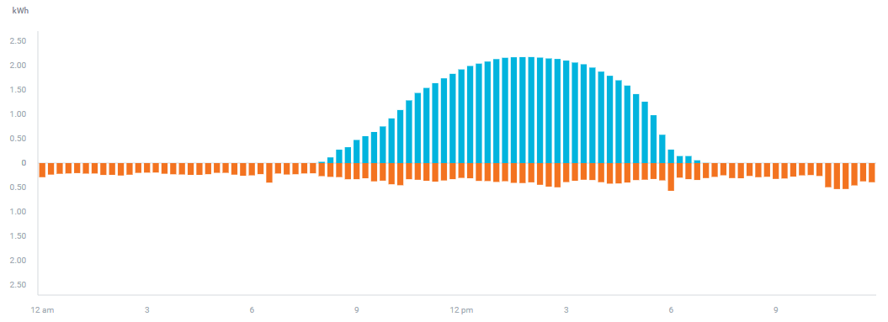
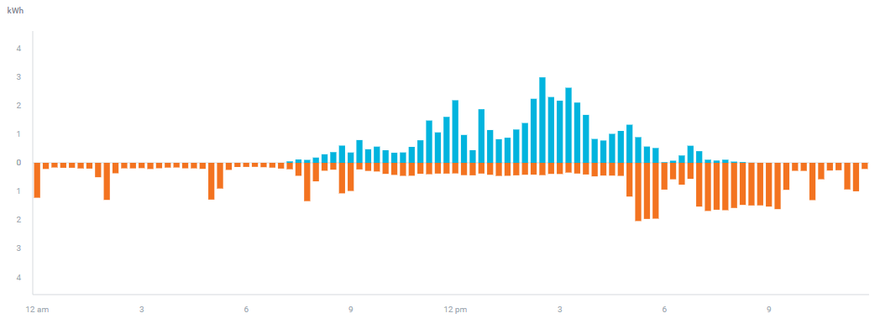
Your Mileage May Vary
9/5/20 -27.4 kwh imported
57.0 kwh exported
Net 29.6 kWh
Wholesale/ Retail is heavily dependent on when you use your power. We make no attempt to use power when we make it.
Good day to do laundry, the dishes, etc.
As batteries come down in cost, net metering will become less important, as it will be viable to store this exported amount and use it later
8/1/20 -40.1 kwh imported
27.3 kwh exported
Net -12.8 kWh
Shift load to here

Slide 26
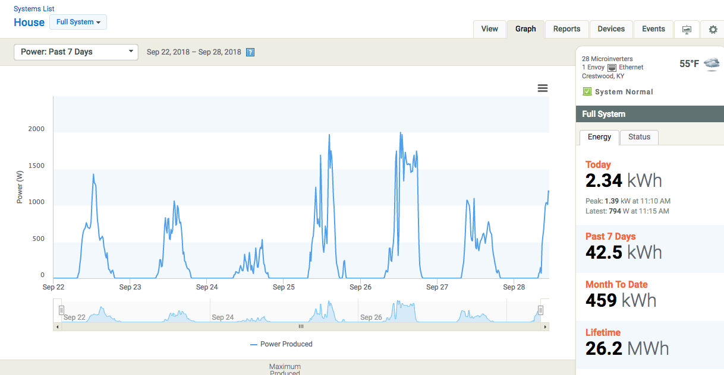
Toys – Enphase enlighten

Slide 27
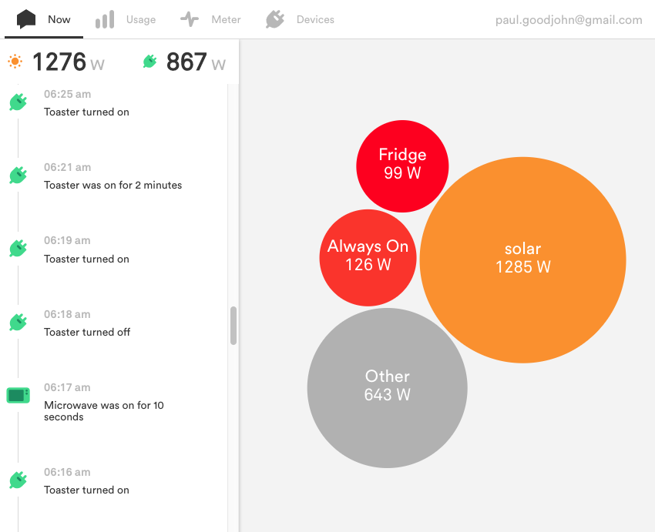
Toys - sense

Slide 28
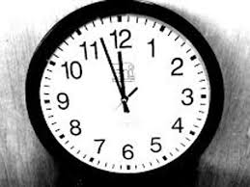
LG&E
“The only change happening on 1/1/2020 is the allowable size system going from 30 kW to 45 kW. Per SB 100, each utility has to apply for and get approval from KY Public Service Commission for the compensation changes for any kWh going back on LG&E’s grid. Our current plan is to apply with PSC in second half of 2020. Until the KPSC approval, all installed solar systems prior to that date will be grandfathered under current rate schedule for 25 years.
If you have any questions, please contact me.
Timothy A. Melton
Manager | Customer Commitment | LG&E and KU
820 West Broadway Street, Louisville, KY 40202
M: 859-221-3221 | O: 502-627-3539 | F:502-217-4944
Timothy.Melton@lge-ku.com
2020-10-12 Update:
“LG&E and KU will be filing its net metering changes by year-end with the PSC.”

Slide 29
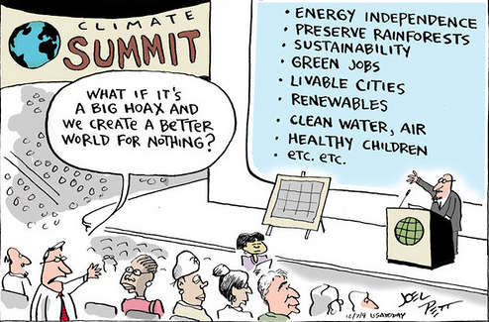
Questions?

